Slide 1


Slide 2

Lecture 4
Accounting Cycle II:
journals, ledgers, trial balance

Slide 3
Learning Outcomes:
Upon successful completion of the session, students will be able to…
To identify and explain the function of the main data sources in an accounting system;
To illustrate the uses of journals and the posting of journal entries into ledger accounts;
To Illustrate how to balance and close a ledger account;
To identify the purpose of a trial balance;
To prepare extracts of an opening trial balance;
To identify and understand the limitations of a trial balance;
To identify the types of error which may occur in bookkeeping systems;
To explain the purpose of bank reconciliations;
To identify the main reasons for differences between the cash book and the bank statement;
To prepare bank reconciliation statements;
To identify errors leading to the creation of a suspense account;
To record entries in a suspense account.

Slide 4
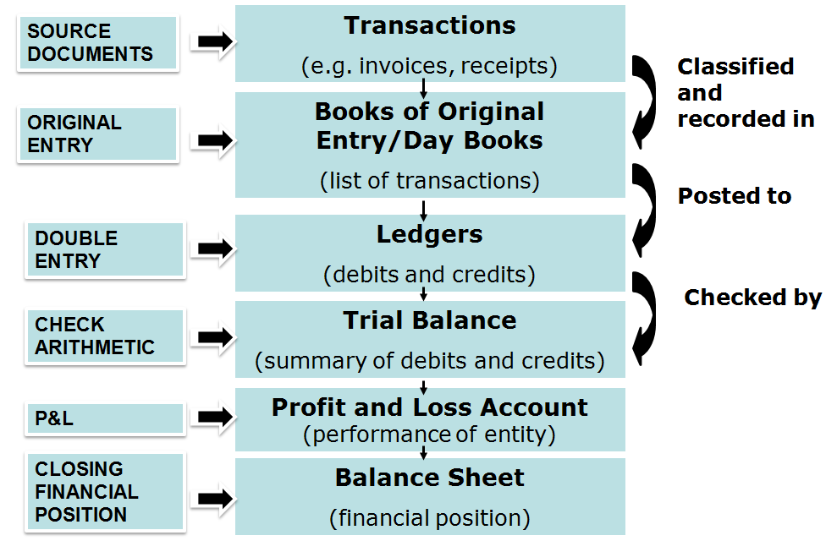
Accounting cycle

Slide 5
Books of original entry
Books of original entry (Day Books) are books in which we first record transactions.
It only lists similar type of transactions in one book.
Day Book types:
Sales Day Book
Purchase Day Book
Returns Inwards Day Book
Returns Outwards Day Book
Cash Book (It also serves as a ledger)
Journal

Slide 6
Books of original entry
BOOK OF ORIGINAL ENTRY | TRANSACTIONS RECORDED | SOURCE DOCUMENT USED
SALES DAY BOOK | CREDIT SALES OF INVENTORY (STOCK) | SALES INVOICES
PURCHASES DAY BOOK | CREDIT PURCHASES OF INVENTORY (STOCK) | PURCHASES INVOICES
CASH BOOK | ALL CASH AND BANK TRANSACTIONS, FOR EXAMPLE, CASH SALES, RECEIPTS FROM DEBTORS (ACCOUNTS RECEIVABLES), PAYMENTS TO CREDITORS | BANK DEPOSIT AND WITHDRAWAL SLIPS, CHEQUES DEBIT AND CREDIT CARD RECEIPTS
RETURN INWARDS JOURNAL | GOODS RETURNED BY CUSTOMERS | CREDIT NOTE SENT
RETURN OUTWARDS JOURNAL | GOODS RETURNED TO SUPPLIERS | CREDIT NOTE RECEIVED
GENERAL JOURNAL | ALL TRANSACTIONS WHICH CANNOT BE RECORDED IN ANY OTHER BOOK OF ORIGINAL ENTRY | BILLS, RECEIPTS, VOUCHERS, CANCELLED CHEQUES.

Slide 7
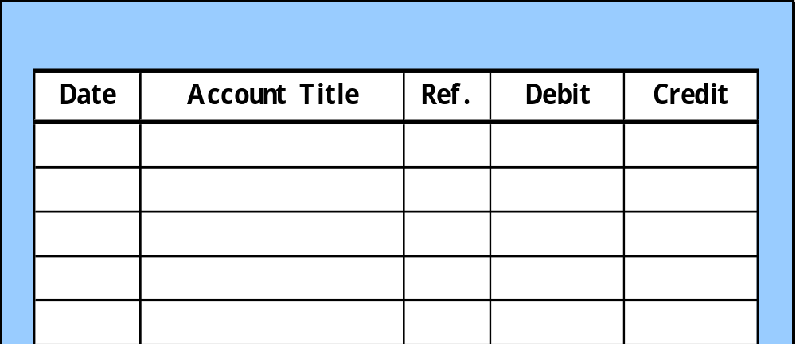
Journalizing
Journalizing - Entering transaction data in the journal.
Illustration: On September 1, Ray Neal invested $15,000 cash in the business, and Softbyte purchased computer equipment for $7,000 cash.
Sept. 1
Cash
15,000
  R. Neal, Capital
15,000
Issued common stock
Computer equipment
7,000
  Cash
7,000

Slide 8
Journalizing
The journal is form of diary for other items that do not
belong to above 5 Day Books.
Some of the main uses of the Journal:
The purchase and sale of fixed assets on credit
Writing off bad debts
The correction of errors in the ledger accounts
Opening entries.
Adjustments to any of the entries in the ledgers

Slide 9
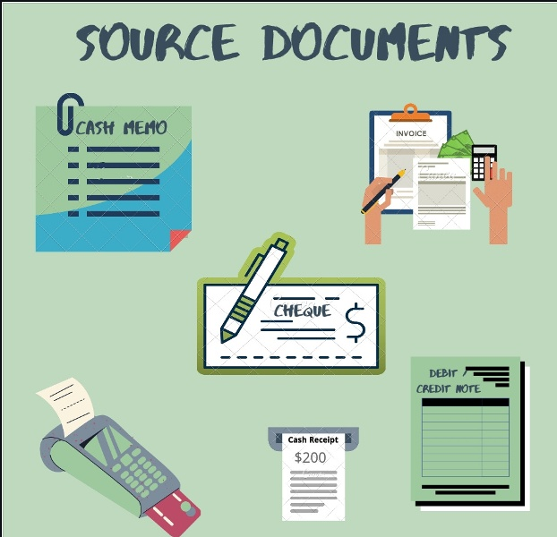
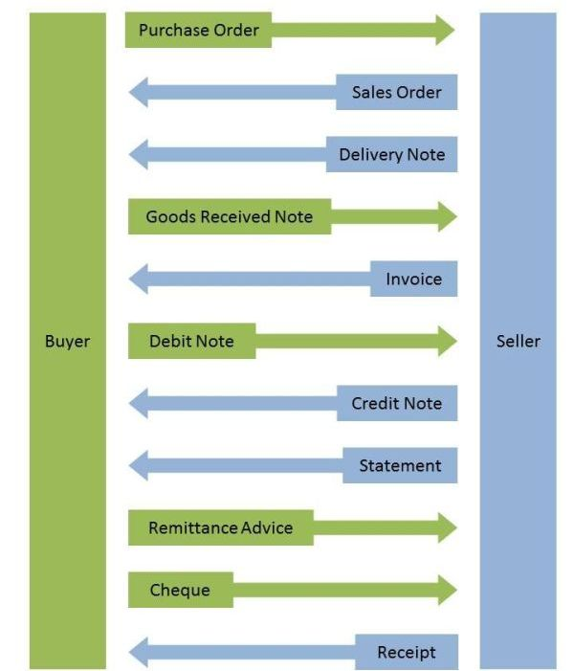
Source documents

Slide 10
Source documents
 | Contents | Purpose
Purchase order | Details of supplier, e.g. name, address. Quantity/description/details of goods required and price. Terms and conditions of delivery, payment, etc. | Sent to supplier as a request for supply.
Delivery note (dispatch note) | Details of supplier, e.g. name and address. Quantity and description of goods. | Provided by supplier. It can be used as a checklist by customer to ensure that everything is there. Every item contained in a delivery note has to be in the accompanying shipment.
Goods received note (GRN) | Quantity and description of goods. | Produced by company receiving the goods as proof of receipt. Matched with delivery note and purchase order.
Invoice | Name and address of supplier and customer, details of goods, e.g. quantity, price, value, sales tax, terms of credit, etc | Issued by supplier of goods as a request for payment. For the supplier selling the goods/services this will be treated as a sales invoice. For the customer this will be treated as a purchase invoice.

Slide 11
Source documents
Debit note | Details of the supplier. Contain details of goods returned, e.g. quantity, price, value, sales tax, terms of credit, etc. | Issued by the company receiving the goods.
Credit note | Details of supplier, e.g. name and address. Contain details of goods returned, e.g. quantity, price, value, sales tax, terms of credit, etc. | Issued by the supplier. Checked with documents regarding goods returned.
Statement | Details of supplier, e.g. name and address. Has details of date, invoice numbers and values, payment made, refunds, amount owing | Issued by the supplier. Checked with other documents to ensure that amount owing is correct.
Remittance advice | Method of payment, invoice number, account number, date, etc. | Sent by a buyer to a seller, informing the seller that an invoice has been paid.
Cheque | The name of the payee, the amount to be paid, and the date. | Issued by the customer. A cheque is an authorization to draw funds from a bank account.
Receipt | Details of payment receipt | Issued by the selling company indicating the payment received.

Slide 12
Invoice: Example
Purchase Order: 10/A/980
Invoice No 16554
Wood&plus Ltd 7 Amir Temur Tashkent 10000 1 July 2017
To: Furniture Co. Ltd 15 Nukus street Tashkent 10000
 | Price per unit ($) | Total ($)
21 counts of Wood (length 4m) 10 boxes nails Terms 1,25% discount if Paid within one month | 20 3 | 420 30

Slide 13
Credit & Debit note
When the seller agrees to take back goods and refund the amount paid in full (or part of it), it will send document called a credit note to customer.
Only then a return is recorded in Returns Inwards Day Book.
If the supplier agrees, goods bought may be returned and customer sends a document called a debit note to the supplier with return details.
Only then a return is recorded in Returns Outwards Day Book.

Slide 14
Credit & Debit note
Debit Note No 989
Furniture Co. Ltd 15 Nukus street Tashkent 10000
To: Wood&plus Ltd 7 Amir Temur str. Tashkent 10000 7 July 2017
 | Price per unit ($) | Total ($)
10 counts of Wood (length 4m) is being returned | 20 | 200

Slide 15
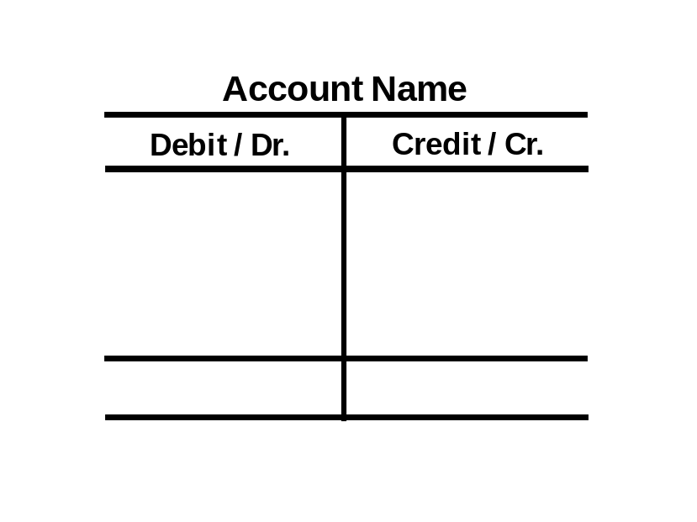
The Account
Record of increases and decreases in a specific asset, liability, equity, revenue, or expense item.
Debit = “Left”
Credit = “Right”
Account
An Account can be illustrated in a T-Account form.

Slide 16
Debit & Credit
Double-entry accounting system
Each transaction must affect two or more accounts to keep the basic accounting equation in balance.
Recording done by debiting at least one account and crediting another.
DEBITS must equal CREDITS.

Slide 17
Rules of Accounting
 | DEBIT | CREDIT
ASSETS | + | -
LIABILITIES | - | +
CAPITAL | - | +
REVENUES | - | +
EXPENSES | + | -
A + E = L + C + R

Slide 18
Balancing off ledger
Calculating and entering the difference between the
totals of the both sides of account
If the debits exceed the credits, the excess is a debit
balance
If the credits exceed the debits, the excess is a credit balance

Slide 19
Example
Bank ledger account Debit Credit
20.01.20 |  | $8,000 | 24.01.20 |  | $1,000
 |  |  | 26.01.20 |  | $2,000
 |  |  | 31.01.20 | balance c/d | $5,000
 |  | $8,000 |  |  | $8,000
01.02.20 | balance b/d | $5,000

Slide 20
Balancing 5 stages
Add up both sides to find out their totals. Note: do not write anything in the account at this stage
Deduct the smaller total from the larger total to find the balance
Now enter the balance on the side with the smallest total. This now means the totals will be equal.
Enter totals which level with each other. Totals are usually double-underlined
Now enter the balance b/d on the line below the totals on the opposite side to the balance c/d shown above the totals.

Slide 21
Balancing off ledger
c/d – carried down on the last day of the period.
The balance c/d is known as the closing balance.
b/d – brought down to start off entries for the following month.
The balance b/d is known as the opening balance

Slide 22
Trial Balance
It is a statement compiled at the end of a specific accounting period
Prove that the total of the accounts with debit balances is equal to the total of the accounts with credit balances
Before preparing financial statements

Slide 23
Example of Trial Balance
PP DESIGN
Trial Balance
February 28, 2019
Name of Accounts | Debit | Credit
Bank | 13,550
Cash | 5,550
Equipment | 8,000
Office Supplies | 500
Artsy Co | 3,000
Prompt Supplier |  | 0
Capital |  | 25,000
Sales |  | 9,000
Discount received |  | 50
Rent expenses | 1,200
Salary expenses | 2,000
Utilities expenses | 250
Total | 34,050 | 34,050

Slide 24
Type of error
ERRORS CAN FALL INTO TWO CATEGORIES:
ERRORS WHERE THE TRIAL BALANCE STILL BALANCES
ERRORS WHERE THE TRIAL BALANCE DOES NOT BALANCE
This shows that whilst the trial balance provides useful control mechanism for detecting errors, a balanced trial balance does not guarantee the accuracy of the financial statements.

Slide 25
Errors where the Trial Balance still balances
Error of omission - no debit or credit entries were made for a particular transaction; completely missed the transaction
For example: Cash sale of $100 was not recorded
Complete reversal of entries – entries were made in the wrong side of the accounts; a transaction requires a debit entry in account A and a credit entry in account B but account A was credited and account B was debited instead
For example: cash sale of $200 has been debited to sales and credited to bank

Slide 26
Errors where the Trial Balance still balances
Error of accounting principle – a transaction may have been entered in the wrong type of account.
For example: The purchase of a new delivery van may have been debited to the purchases account instead of the delivery vans account.
Error of original entry – the original figure was incorrectly entered in both accounts.
For example:
A cash sale of $76 has been recorded as $67

Slide 27
Errors where the Trial Balance still balances
Compensating errors – an error on one side of the ledger account is compensated or “cancelled” by an error of equal amount on the other side of the account.
For example: Both the Bank and the Trade Creditor accounts were each incorrectly reduced by an equal amount of $100
Error of commission – entries were made on the correct sides of the accounts but to the wrong personal account.
For example: credit sales to C Green were incorrectly recorded in the accounts of K Green.

Slide 28
Errors where the trial balance does not balance
Single sided entry – a debit entry has been made but no corresponding credit entry or vice versa
Debit and credit entries have been made but at different values
Opening balance has not been brought down
Two debit or two credit entries have been posted

Slide 29
What to do if trial balance is not balanced?

Slide 30
Suspense accounts
A suspense account is an account in which debits or credits are held temporarily until sufficient information is available for them to be posted to the correct accounts.
There are two main reasons why suspense accounts may be created.
On the extraction of trial balance the debits are not equal to the credits and the difference is put to the suspense account.
When a bookkeeper performing double entry is not sure where to post one side of an entry they may debit or credit a suspense account and leave the entry there until its ultimate destination is clarified.
For example: A cash payment might be made and must obviously be credited to cash. But the bookkeeper may not know what the payment is for, and so will not know which account to debit.
The balance on the suspense account must be cleared before final accounts can be prepared

Slide 31
Suspense accounts
Example: The purchase of a non-current asset costing $100 has been recorded by debiting $10 to the non-current assets account and crediting $ 100 to cash
What should the double entry have been? (“Should do”) | What was the double entry? (“Did do”) | Correcting journal
Dr NCA $100 Cr Cash $100 | Dr NCA $10 DrSuspense $90 (bal. fig) CrCash $100 | Dr NCA $90 Cr Suspense $90
When the mystery is solved, the suspense account is closed and the amount correctly posted using a journal entry.
Suspense accounts are only temporary. None should exist when it comes to drawing up the financial statements at the end of the accounting period.

Slide 32
Bank reconciliations
In theory, the entries appearing on a business's bank statement should be exactly the same as those in the business cash book. The balance shown by the bank statement should be the same as the cash book balance on the same date.
A bank reconciliation is a comparison of a bank statement (sent monthly, weekly or even daily by the bank) with the cash book. Differences between the balance on the bank statement and the balance in the cash book will be errors or timing differences, and they should be identified and satisfactorily explained.
Our Company
( Business)
Cash Book
Bank
(e.g.OFB,Kapitalbank, etc.)
Bank statement

Slide 33
Why might your own estimate of your bank balance be different from the amount shown on your bank statement?
There are three common explanations:
Error. Errors in calculation, or recording income and payments, are more likely to have been made by you than by the bank, but it is conceivable that the bank has made a mistake too.
Bank charges or bank interest. The bank might deduct charges for interest on an overdraft or for its services, which you are not informed about until you receive the bank statement.
Timing differences These items have been recorded in the cash book , but due to the bank clearing process have not yet been recorded in the bank statement
Outstanding/ unpresented cheques- cheques sent to suppliers but not yet cleared by the bank.
Outstanding/uncleared lodgements- cheques received by the business but not yet cleared by the bank

Slide 34
It is necessary to remember, however, that if a customer has money in their account, the bank owes them that money, and the customer is therefore a payable of the bank (hence the phrase 'to be in credit’ means to have money in your account).
This means that if a business has $8,000 cash in the bank, it will have a debit balance in its own cash book, but the bank statement, if it reconciles exactly with the cash book, will state that there is a credit balance of $8,000. (The bank's records are a 'mirror image' of the customer's own records, with debits and credits reversed).

Slide 35
Lecture Roundup:
Business transactions are recorded on source documents. Examples include sales and purchase orders, invoices and credit notes.
The journal is the record of prime entry for transactions which are not recorded in any of the other books of prime entry.
The receivables and payables ledgers contain the personal accounts of individual customers and suppliers. They do not normally form part of the double entry system.
At suitable intervals, the entries in each ledger account are totalled and a balance is struck. Balances are usually collected in a trial balance which is then used as a basis for preparing a statement of profit or loss and a statement of financial position.
A trial balance can be used to test the accuracy of the double entry accounting records. It works by listing the balances on ledger accounts, some of which will be debits and some credits. The total debits should equal total credits.

Slide 36
6. Differences between the cash book and the bank statement arise for three reasons.
– Errors – usually in the cash book
– Omissions – such as bank charges not posted in the cash book
– Timing differences – such as unpresented cheques .
7. Errors which leave total debits and credits in the ledger accounts in balance can be corrected by using journal entries. Otherwise a suspense account has to be opened first, and later cleared by a journal entry.
8. Suspense accounts, as well as being used to correct some errors, are also opened when it is not known immediately where to post an amount. When the mystery is solved, the suspense account is closed and the amount correctly posted using a journal entry.
9.Suspense accounts are only temporary. None should exist when it comes to drawing up the financial statements at the end of the accounting period.

Slide 37
References:
Wood, F. and Sangster, A. (2005). Business Accounting 1, 10th ed., FT: Prentice Hall, chapters 5, 6, 25, 26, 28, 32
Horngren & Harrison (2008), Financial and Managerial Accounting, Pearson Prentice Hall, chapter 2.
Dyson, J.R (2004) Accounting for Non-Accounting Students, chapter 3 & 5.
Britton, A. and Waterston, C. (2003) Financial Accounting, 3rd ed., FT: Prentice Hall, chapter 5.
Gillespie et al (2000) Principles of Financial Accounting, 2nd ed., FT: Prentice Hall, chapter 3.
Glautier, M & Underdown B (2001) Accounting Theory and Practice, 7th edition, chapters 7 & 8
ACCA (2017) Approved Interactive Text. Foundations in Accountancy FFA 2017/2018. BPP Media Ltd.

